Slide 1

dibimbing id
2025
Exploratory Data Analisis (EDA)
Data Science, AI & ML Job Salary in 2025 Data Set
Deanova Cella Fadila

Slide 2

Background
Data Science, AI, and Machine Learning careers are becoming increasingly popular in today’s digital age. Many are interested in entering the field, but clear information about how salaries grow with experience is still limited. This analysis offers insight into 2025 salary trends to help the public understand career potential in this field.
Source: https://www.kaggle.com/datasets/adilshamim8/salaries-for-data-science-jobs

Slide 3


Project Goals
Analyze salary trends in Data Science, AI, and ML based on experience level.
Provide clear data visualizations for a general audience.
Help aspiring professionals understand income potential in the field.
Promote data-driven understanding in choosing and planning a digital-era career path.

Slide 4
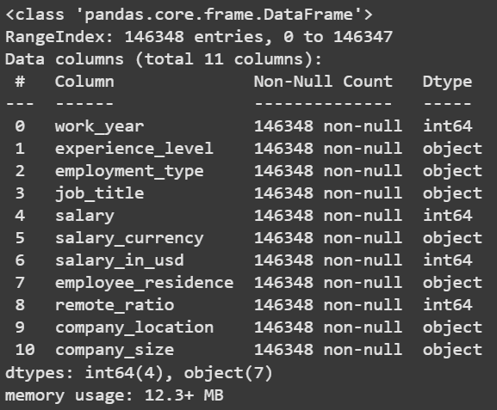
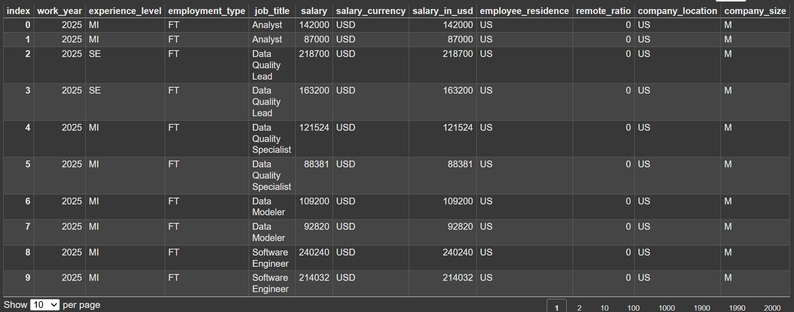
Data Set Overview
This dataset contains 69860 rows × 11 columns

Slide 5
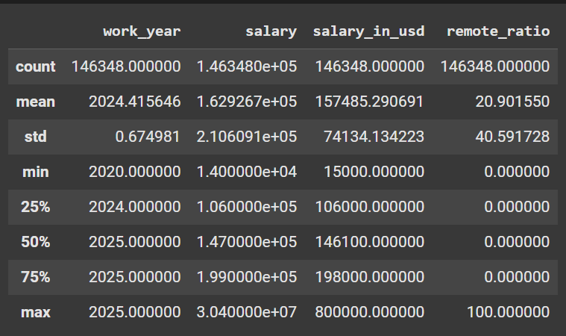
Statistical Summary
Total data entries: 146,348 records
Time span: 2020 to 2025
Average salary: $162,927
Average adjusted salary in USD: $157,486
Minimum salary: $14,000, Maximum salary: $30,400,000
Median salary: $147,000
75% of workers earn less than $199,000
High standard deviation indicates significant salary disparity
Most jobs are still non-remote (average remote ratio only 20.9%)
Remote ratio max is 100%, indicating the presence of fully remote jobs

Slide 6
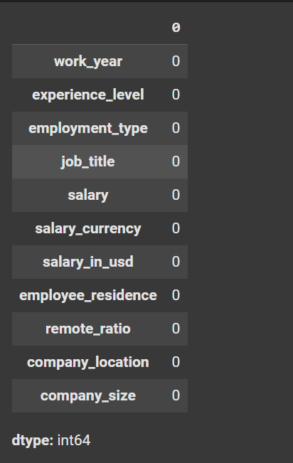
Rimberio
June 13, 2038
Checking Missing Value
The dataset is 100% complete.
There are no missing values in any of the following key columns. This clean dataset ensures that all analyses and visualizations are based on complete and consistent data.

Slide 7
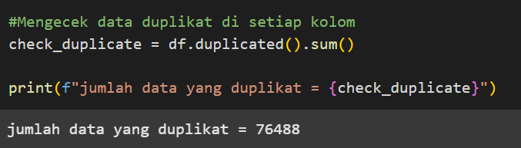
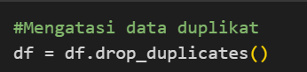
Handling Duplicates
A total of 76,488 duplicate rows were found in the dataset. This is a significant number and could affect the accuracy and validity of the analysis.
To resolve this issue, the duplicate data was removed using the drop_duplicates() function from the pandas library.
After the cleaning process, the number of duplicate entries was successfully reduced to 0. This ensures that each row is unique and the analysis can proceed with accurate results.

Slide 8
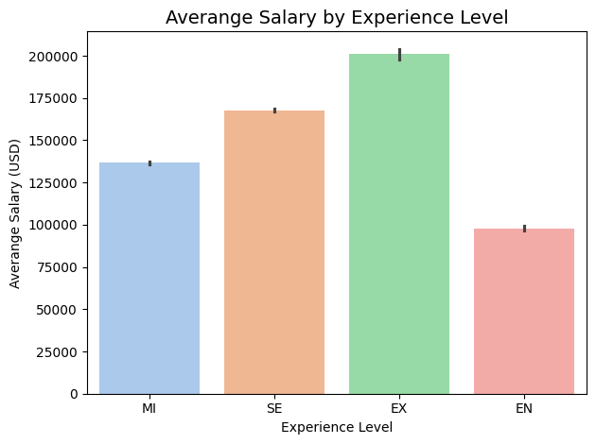
Salary by Experience
🔹 EN (Entry-Level):
Entry-level positions offer the lowest average salary at approximately $98,000 USD, representing the starting point of a professional career.
🔹 MI (Mid-Level):
Mid-level professionals earn an average of $137,000 USD, showing a substantial increase from entry-level roles.
🔹 SE (Senior-Level):
Senior-level employees receive an average salary of around $168,000 USD, reflecting the higher value placed on experience and expertise.
🔹 EX (Executive-Level):
Executives have the highest average salary, exceeding $200,000 USD, highlighting the premium paid for strategic leadership roles.
The data clearly shows that salary increases with experience level, emphasizing the importance of career growth and continuous skill development in the tech industry

Slide 9


Thank You
Deanova Cella Fadila
https://www.linkedin.com/in/deanovacellafadila27
deanovacellafadila27@gmail.com

